Slide 1
Introduction to Programming in Python
Ezekiel Adebayo Ogundepo (@gbganalyst)

Slide 2
Variable assignment

Slide 3
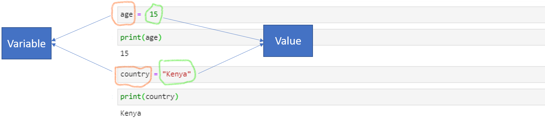
Variable Assignment
A variable is a way at which a programmer stores a value so that it can be used over and over without having to repeat oneself.
The equality operator (=) sign is called an assignment.

Slide 4
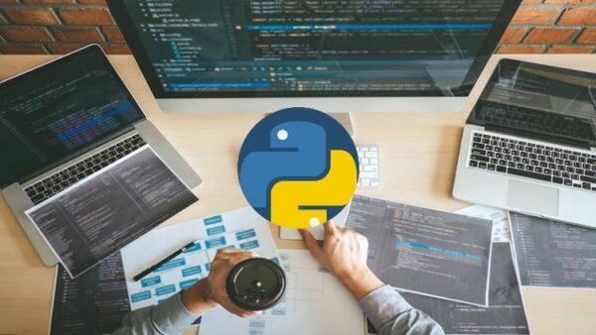
Lab session

